Slide 1
Ketamine and its metabolites and their potential use for the treatment of depression
Irving W. Wainer, PhD, DHC
Ketamine
A chiral phencyclidine derivative introduced in the 1960’s as an intravenous anesthetic
Domino et al. (1965) Clin Pharmacol Ther
Domino (2010) Anesthesiology

Slide 2
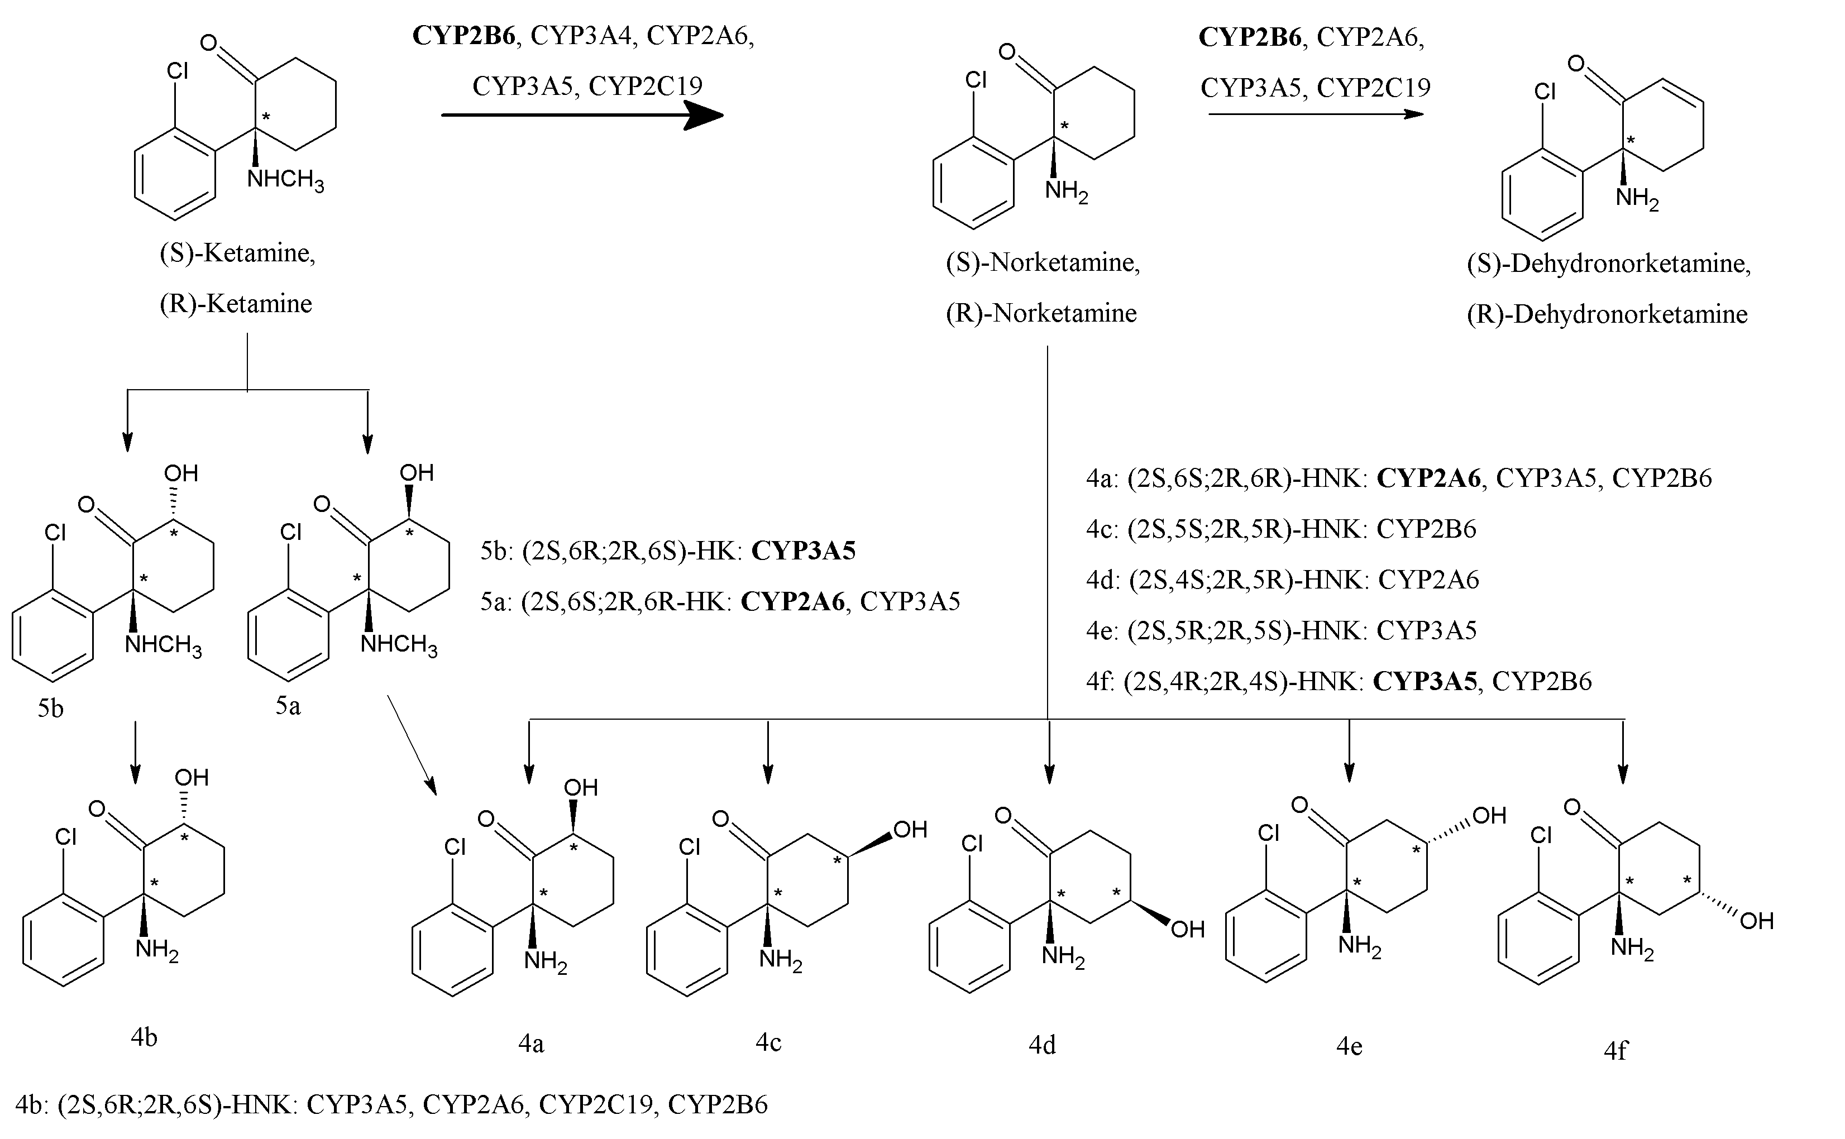
(R,S)-Ket is extensively metabolized by cytochrome P450 enzymes

Slide 3
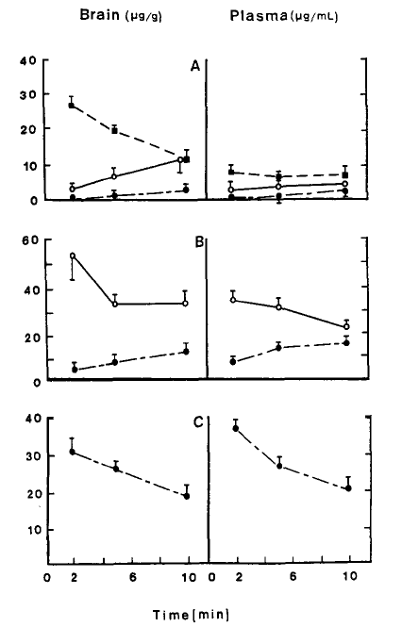
Initial pharmacodynamic studies of the effects produced by the administration of anesthetic doses of (R,S)-ketamine, (R,S)-norketamine and (2S,6S;2R,6R)-HNK in the rat
Leung LY, Baillie TA (1986) J Med Chem 29:2396-9.
RESULTS
Ket → norKet → HNK
A. (R,S)- Ket 
B. (R,S)-norKet ○
C. (2S,6S;2R,6R)-HNK 
compounds pass blood brain barrier
CNS activities associated with general anesthesia and recovery were produced by (R,S)-Ket and (R,S)-norKet, while (2S,6S;2R,6R)-HNK was “inactive”

Slide 4
The “ketamine paradigm”
The major metabolite of ketamine is norketamine
The therapeutic activity is due to ketamine and norketamine
(R,S)-Ket and (R,S)-norKet are NMDA inhibitors and this is the basis for their pharmacological effects
(R,S)-Ket is an antidepressant agent
The administration of a sub-anesthetic dose of (R,S)-Ket (0.5 mg/Kg as a 40-min iv infusion) produces rapid (within 2 hr) and sustained (up to 7 days) antidepressant effects in patients suffering from treatment-resistant major depressive disorder and bipolar depression.
The “Ketamine paradigm” does not work for sub-anesthetic dosing of (R,S)-Ket
It has not been possible to establish pharmacodynamic relationships for the antidepressant effects produced by sub-anesthetic doses of (R,S)-Ket when only the plasma concentrations of (R,S)-Ket and (R,S)-norKet have been modeled.

Slide 5
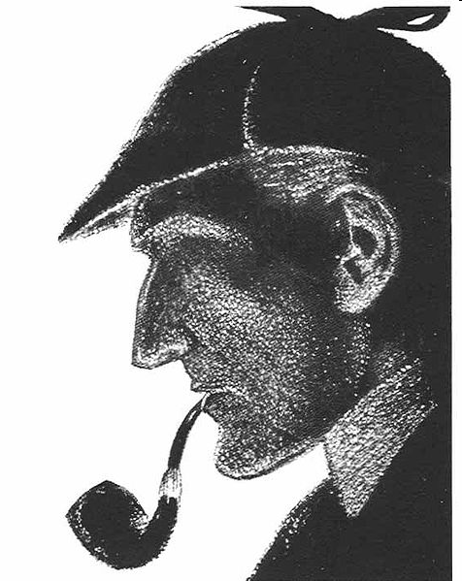
It is a capital mistake to theorize before one has data. Insensibly one begins to twist facts to suit theories, instead of theories to suit facts. Sherlock Holmes in “A Scandal in Bohemia” Arthur Conan Doyle

Slide 6
Plasma concentrations (ng/ml) of ketamine and metabolites in 67 patients experiencing a major depressive disorder treated with (R,S)-ketamine as a 40-min infusion (0.5 mg/kg)
Zhao X, et al., (2012) Br J Clin Pharmacol

Slide 7
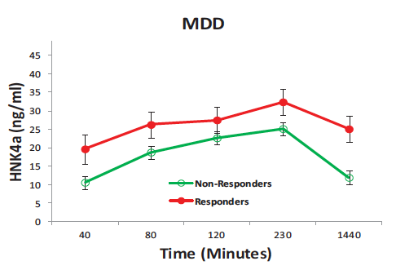
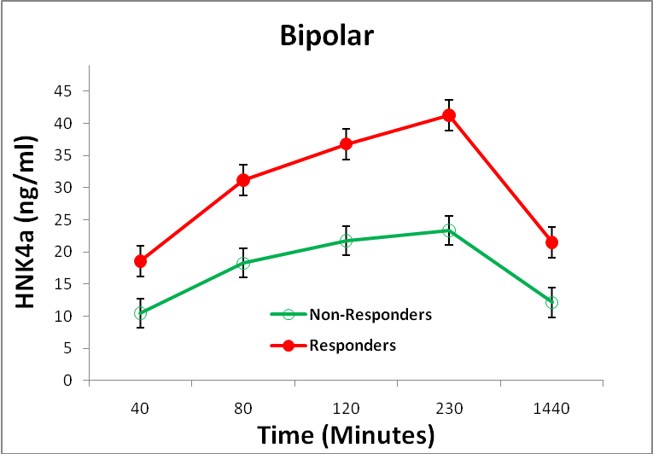
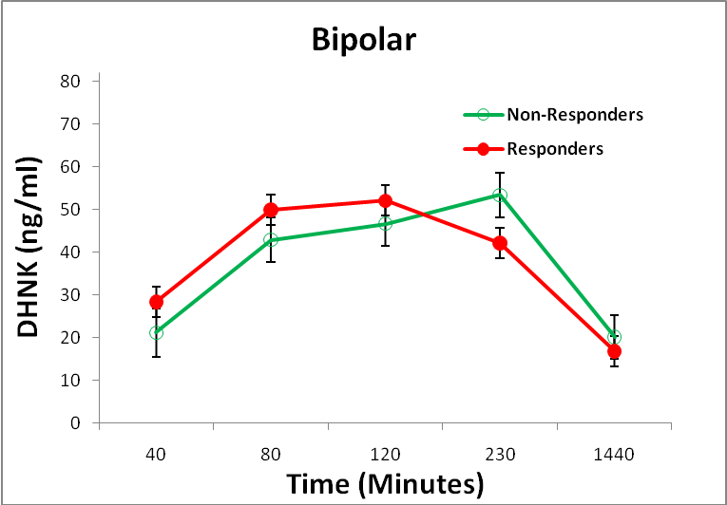
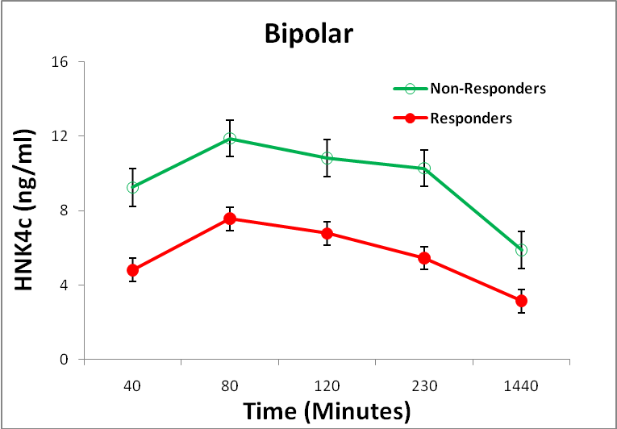
(R,S)-Ket metabolites contribute to the observed antidepressant response The analysis of the clinical responses measured as percent change in the MADRS score indicated that (R,S)-DHNK, (2S,6S;2R,6R)-HNK (HNK4a) and (2S,4R;2R,4S)-HNK (HNK4f) were associated with reduced psychotic and dissociative symptoms at 40 min
Zarate, CA Jr, et al (2012) Biol Psychiatry

Slide 8
Are (2R,6R)-HNK and (2S,6S)-HNK antidepressants?

Slide 9
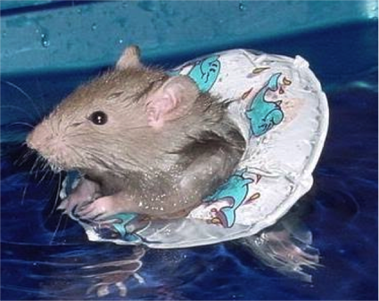
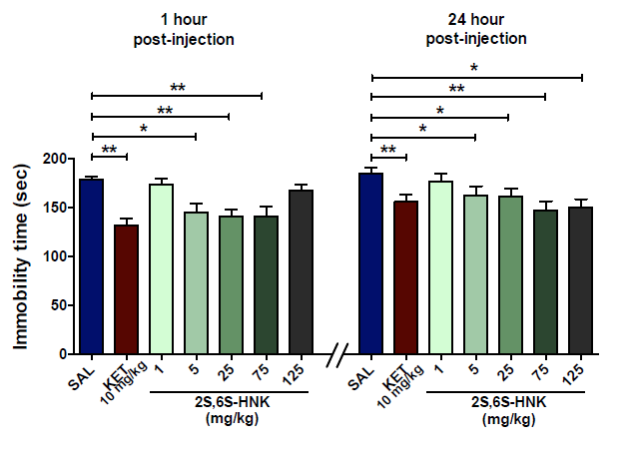
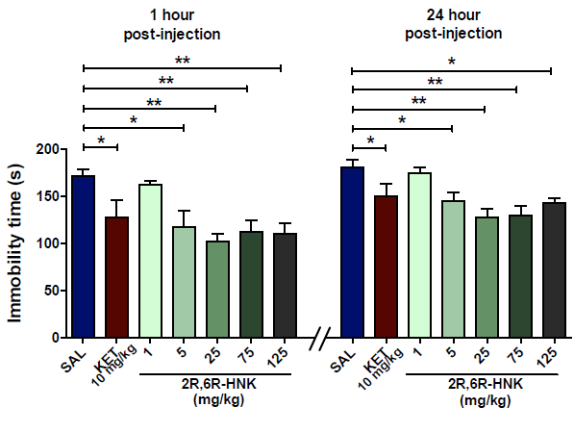
(2S,6S)-HNK and (2R,6R)-HNK decrease depressive-like behaviour Immobility time in a Forced Swim Test
➔ The FST is a classic tests of antidepressant efficacy used in behavioral pharmacology.
➔ Every known antidepressant drug exert antidepressant effects in this test
➔ A positive effect in the FST is expected prior to undertaking human clinical trials.
Panos Z, et al. (2106) Nature

Slide 10
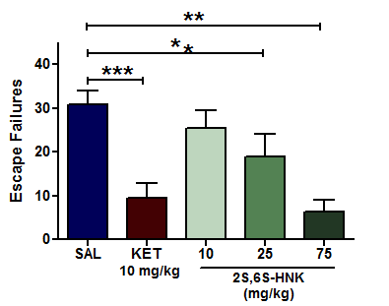
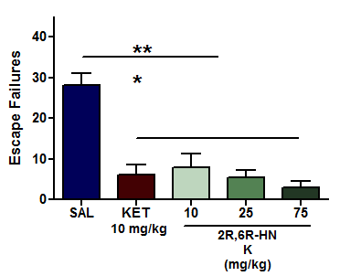
(2S,6S)-HNK and (2R,6R)-HNK decrease depressive-like behavior
Learned Helplessness
Panos Z, et al. (2106) Nature

Slide 11
Are the antidepressant effects due to NMDAR inhibition?
The binding affinities (K_{i} values) to the NMDAR determined using displacement binding studies with [³H]-MK801 as the marker ligand
Compound | K_{i} (μM) | α
(R )-Ketamine | 2.6
(S)-Ketamine | 0.7 | 3.7
(R )-Norketamne | 26.5
(S)-Norketamine | 2.3 | 11.5
(R )-Dehydronorketamine | 74.6
(S)-Dehydronorketamine | 38.9 | 1.9
(2R,6R)-Hydroxynorketamine | >100
(2S,6S)-Hydroxynorketamine | 21.2 | >5
Moaddel, et al. (2013) Eur J Pharmacol

Slide 12
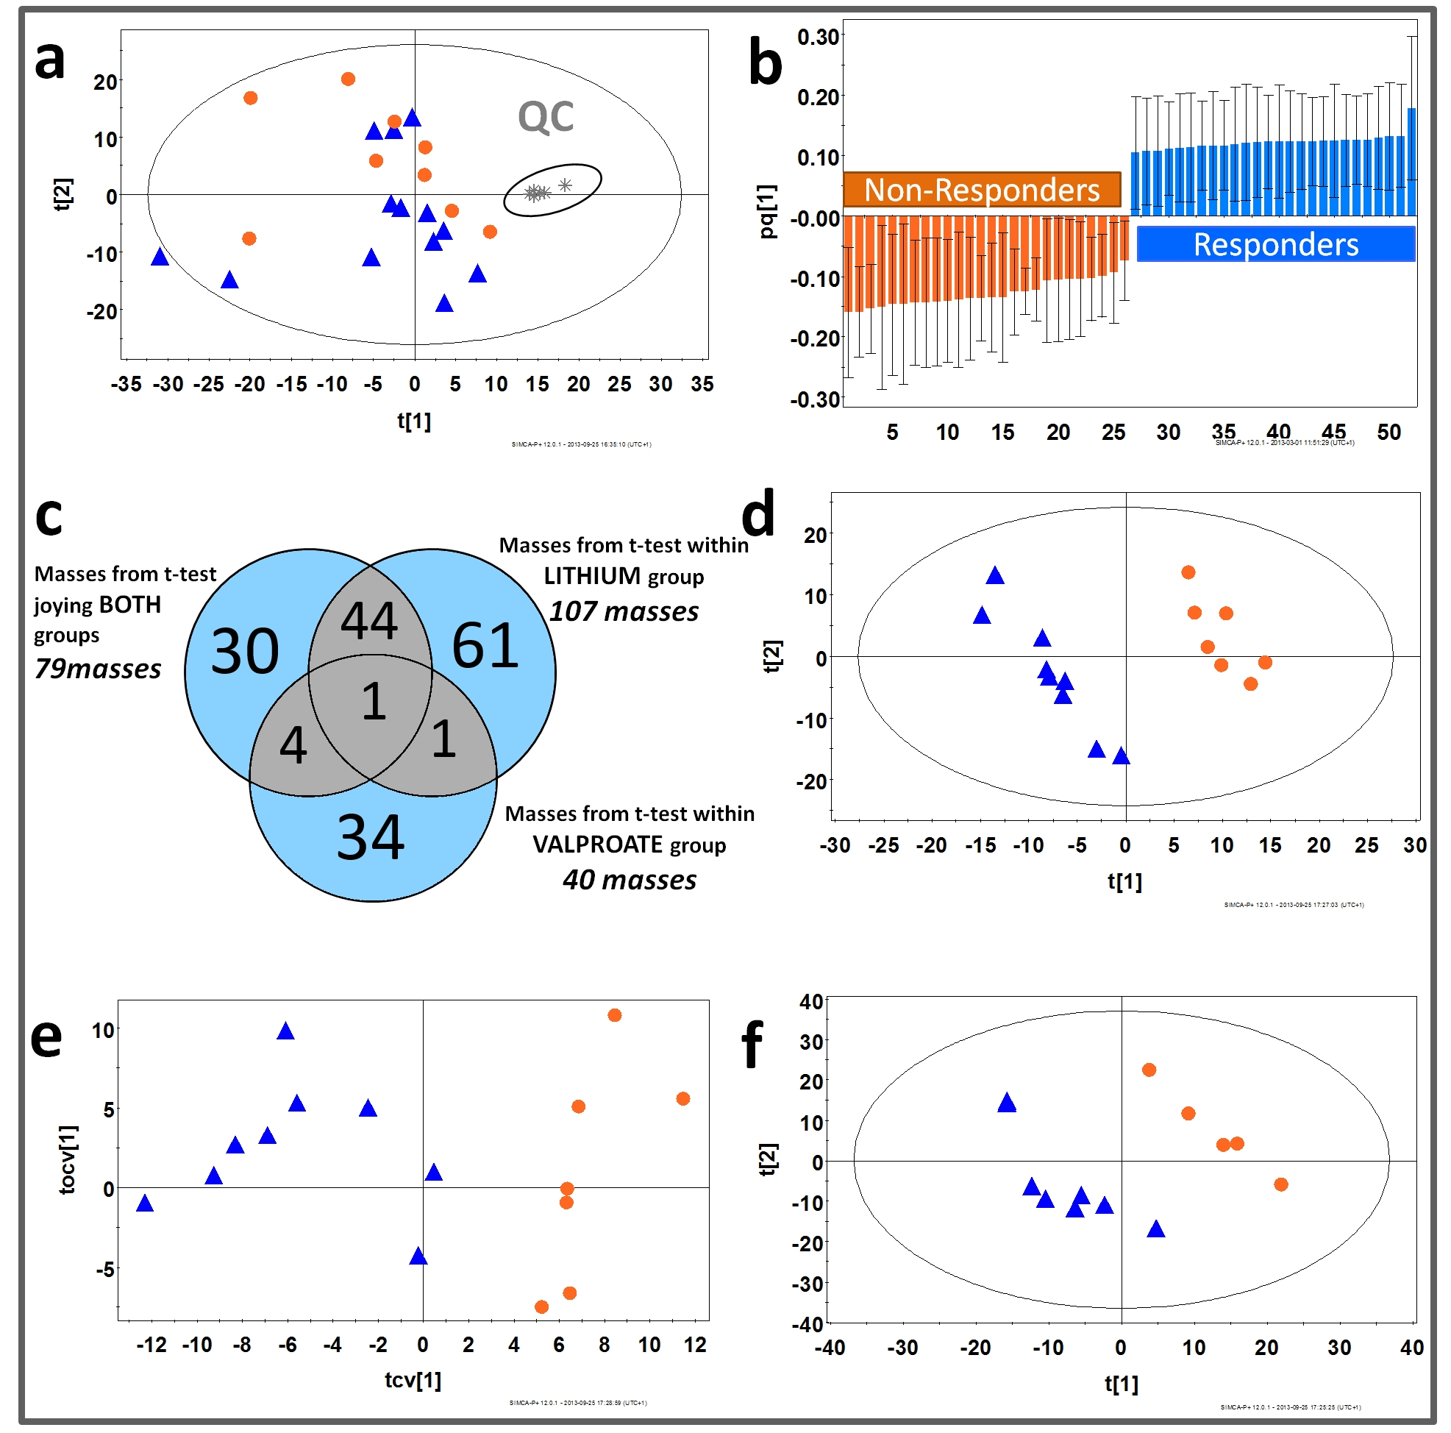
How does HNK work? Non-targeted metabolomics study of (R,S)-Ket responders and non-responders 18 biomarkers identified, 4 were lysophosphatidylethanolamines and 9 lysophosphatidylcholines which were increased in responders relative to non-responders. The results indicate that the differences between patients who respond to (R,S)-Ket and those who do not are due to alterations in the mitochondrial β-oxidation of fatty acids.
Villaseñor et al. (2014) Br J Pharmacol

Slide 13
Another key observation from the non-targeted metabolomics study was that the plasma levels of D-serine were lower in responders relative to non-responders.
D-Serine is a co-agonist of the NMDA receptor.
Plasma D-serine levels measured in 21 patients with major depressive disorder (MDD) before and after a 40-min infusion of ketamine (0.5 mg/kg) with 8 non-responders (Non-Resp) and 13 responders (Resp)
*
Moaddel R, et al. (2015) Psychopharmacology

Slide 14
Baseline D-Serine as a response marker
There is a relationship between baseline D-serine and L-serine and antidepressant response to (R,S)-Ket with lower levels predicting a better response {measured as percent change in MADRS score at 230 min post administration}
Moaddel R, et al. (2015) Psychopharmacology

Slide 15
Effect of ketamine and ketamine metabolites on D-serine concentration in PC-12 cells The data is expressed as IC₅₀ values and percent (%) maximum decrease from vehicle-treated cells. The effect of the configuration at the chiral centers on the magnitude of the IC₅₀ value represented as the enantioselectivity factor (α) is derived by IC₅₀(2R isomer)/IC₅₀(2S isomer).
Compound | IC₅₀ (nM) | Compound | IC₅₀ (nM) | Enantioselectivity (α)
(R)-Ket | 940 ± 160 (-33 ± 8%) | (S)-Ket | NA | NA
(R.)-norKet | 91.0 ± 5.9 (-39 ± 2%) | (S)-norKet | 62.4 ± 1.0 (-29 ± 1%) | 1.5
(R.)-DHNK | 102 ± 11 (-32 ± 9%) | (S)-DHNK | 50.9 ± 6.2 (-30 ± 2%) | 2.0
(2R,6R)-HNK | 0.68 ± 0.09 (-35 ± 3%) | (2S,6S)-HNK | 0.18 ± 0.04 (-39 ± 5%) | 3.8
(2R,6S)-HNK | 2.34 ± 0.32 (-57 ± 5%) | (2S,6R)-HNK | 1.11 ± 0.24 (-51 ± 4%) | 2.1

Slide 16
Effect of (R)-Ket and (S)-Ket on intracellular and extracellular D-Ser concentrations
intracellular
extracellular
(S)-Ket is a selective and potent inhibitor of ASCT2-mediated D-Ser transport (IC₅₀ 0.82 μM)
Singh NS, et al. (2015) Br J Pharmacol

Slide 17
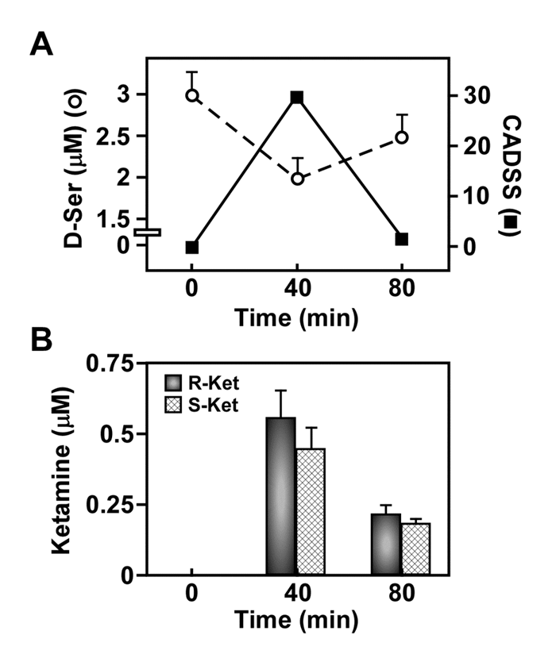
Potential clinical effect of (S)-Ketamine inhibition of ASCT2 transport
Changes in CADSS scores are associated with changes in the plasma concentrations of D-serine and (S)-ketamine and (R)-ketamine

Slide 18
A New Ketamine-Paradigm
Indirect pharmacological cascades
The hypothesis
*Ketamine metabolites are selective and potent inhibitors of the
α7 nAChR, which reduces intracellular calcium concentrations
*Decreased intracellular calcium reduces serine racemase activity
*Decreased serine racemase activity reduces the activity of the
NMDA receptor
Serine racemase
activity
D-serine
NMDA receptor
activity

Slide 19
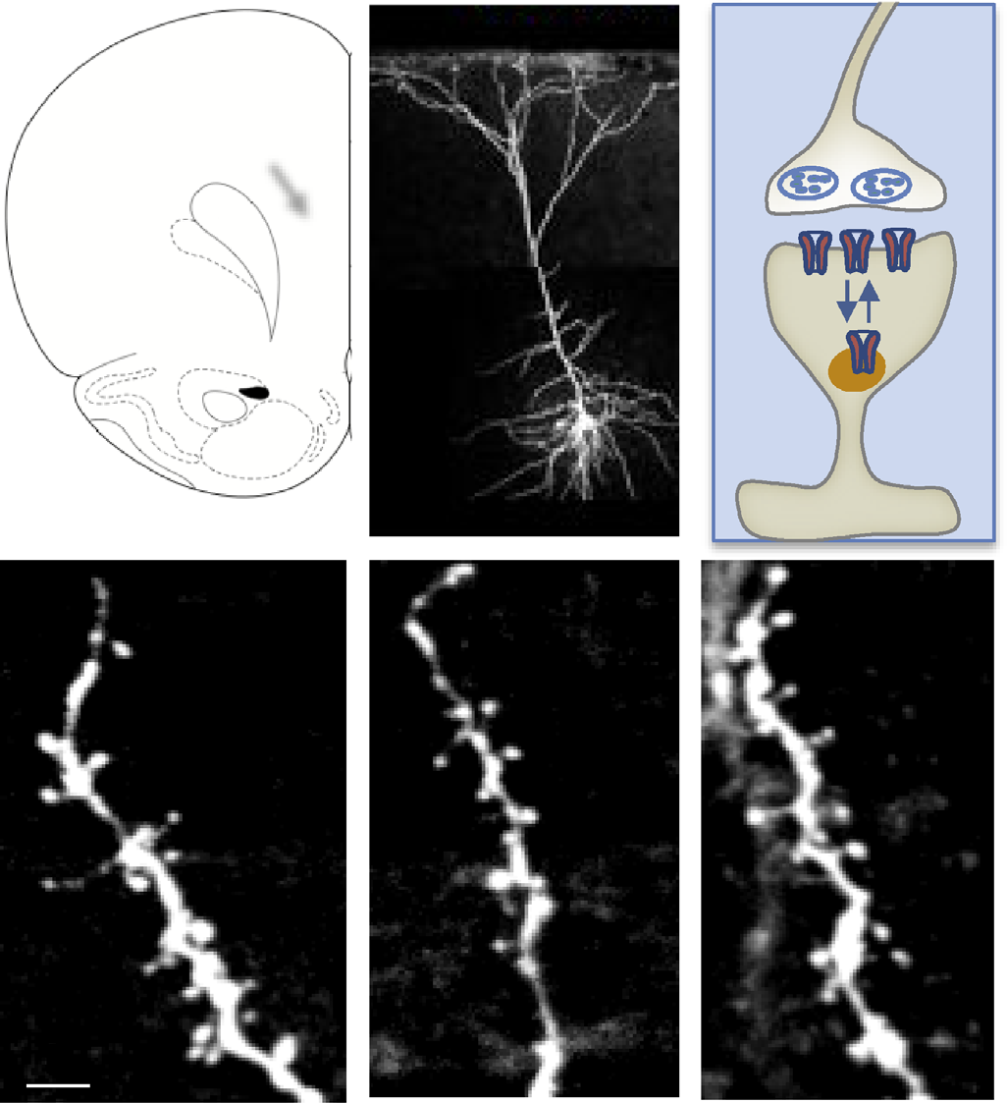
Effect of Ket on chronic stress-induced atrophy of pyramidal neurons in the rat
Dwyer and Duman, Biol. Psychiatry, 73: 1189-1198, 2013
Control
Stress
Ket

Slide 20
Concentration of (R,S)-Ket and metabolites in brain tissue of Wistar rats at 10 min post ip injection of (R,S)-Ket [40 mg/Kg]
1.9e6
1.8e6
2
9.3e4
4a
1
1.7e6
9.0e4
1.6e6
8.5e4
(2S,6S;2R,6R)-HNK
24,151 ng/g
(R,S)-norKet
36,561 ng/g
(R,S)-Ket
17,076 ng/g
8.0e4
1.5e6
7.5e4
7.0e4
1.4e6
6.5e4
1.3e6
6.0e4
5.5e4
1.2e6
5.0e4
Intensity, cps
4.5e4
1.1e6
4.0e4
1.0e6
3.5e4
Intensity, cps
3.0e4
9.0e5
2.5e4
4b
2.0e4
4f
8.0e5
1.5e4
4c
7.0e5
1.0e4
4d
5000.0
6.0e5
0.0
2
4
6
8
10
12
14
16
18
20
22
24
26
28
Time, min
5.0e5
4.0e5
3.0e5
2.0e5
1.0e5
0.0
2
4
6
8
10
12
14
16
18
20
22
24
26
28
Time, min
Paul RK, et al. (2014) Anesthesiology

Slide 21
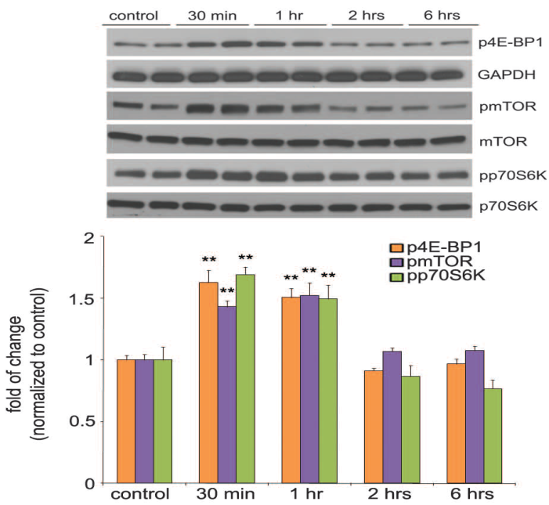
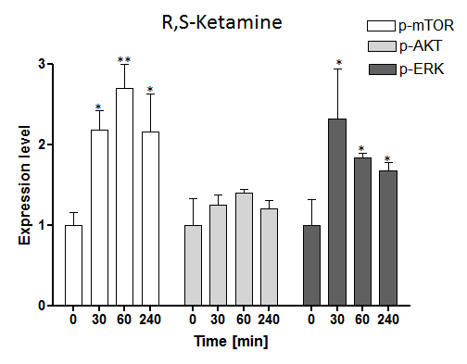
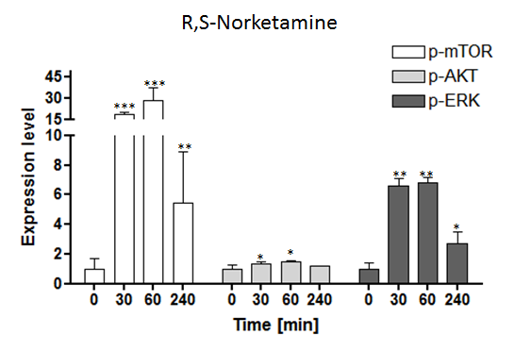
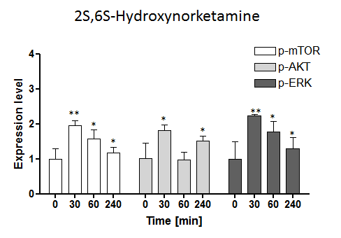
A
B
C
D
(A) Time course of ketamine induced mTOR signaling determined by Western blot analysis of pmTOR, p4E-BP1, and pp70S6K in synaptoneurosomes of PFC. [Nanxin et.al (2010) Science]; Western blotting in rat brain (cortex) tissues treated with (B) R,S-Ketamine, (C) R,S-Norketamine and (D) 2S,6S-Hydroxynorketamine to check the expressions of total and phosphorylated forms of mTOR, ERK and Akt (Paul, et al. (2014) Anesthesiology)

Slide 22
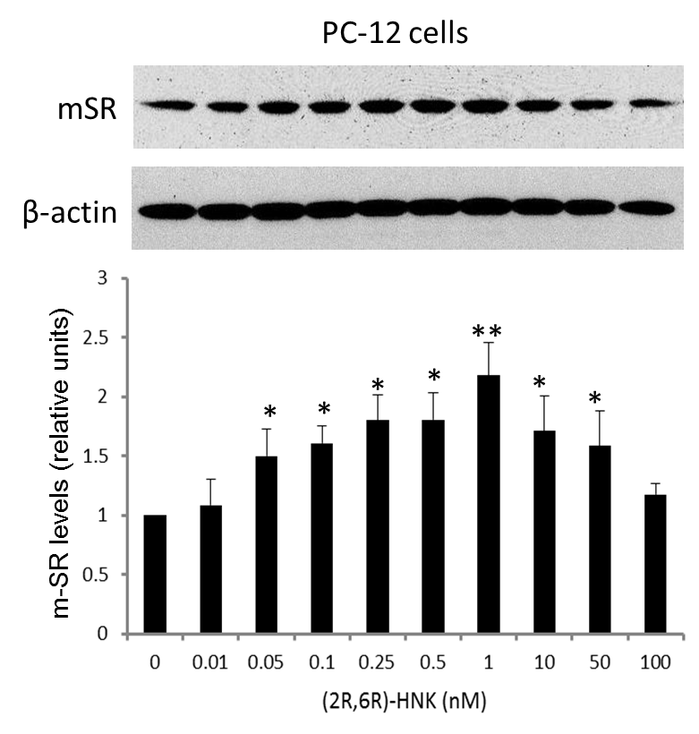
Expression of m-SR protein in PC-12 cells after treatment with (2R,6R)-HNK for 36 h.
Singh, NS, et al. (2016) PlosOne

Slide 23
Proposed cellular mechanism
HNK
PI-3K
α7-nAchR
B
PDK1
A
mTORC2
P
Ca²⁺
AKT
P
P
AKT
mTORC1
SR
SR
p70S6K
4E-BP1
D-Ser
L-Ser
Protein translation
Depression, AD,
PD, ALS, PTSD, ?
NMDAR
Ca²⁺
C
Ca²⁺
D-Ser
Synaptic death
Neurotoxicity
glutamate

Slide 24
What about neuropathic pain?
We have no direct data regarding ketamine metabolites. However, gabapentin and (S)-pregabalin decrease intracellular D-serine concentrations in PC-12 cells, but do not increase serine racemase expression – a Ca²⁺ effect?
Singh, et al. (2013) Neurosci Lett

Slide 25
The average plasma concentrations of (R)- and (S)-ketamine and (R)- and (S)-norketamine in 16 CRPS patients receiving a sub-anesthetic dose of (R,S)-ketamine as a 24h continuous infusion for 5 days and the corresponding mean pain scores.
Goldberg ME, et al. (2010) Pain Physician

Slide 26
Perhaps we should not get caught in the “New” Ketamine Paradigm
The effect of 14-day ip administration of (R,S)-ketamne on 30 min plasma concentrations
NC
- 40%
+ 350%
+ 40%

Slide 27
The concentrations of ketamine metabolites in the plasma of a CRPS patient on Day 3.
Moaddel R, et al., (2010) Talanta

